Slide 1
LINK
GROUP
LINK
Automation Engineering (Shanghai) Co.,Ltd.
GROUP
霖和自动化工程(上海)有限公司
Training Record
Pham Tung Lam : PLC Engineer
Module Software structure

Slide 2
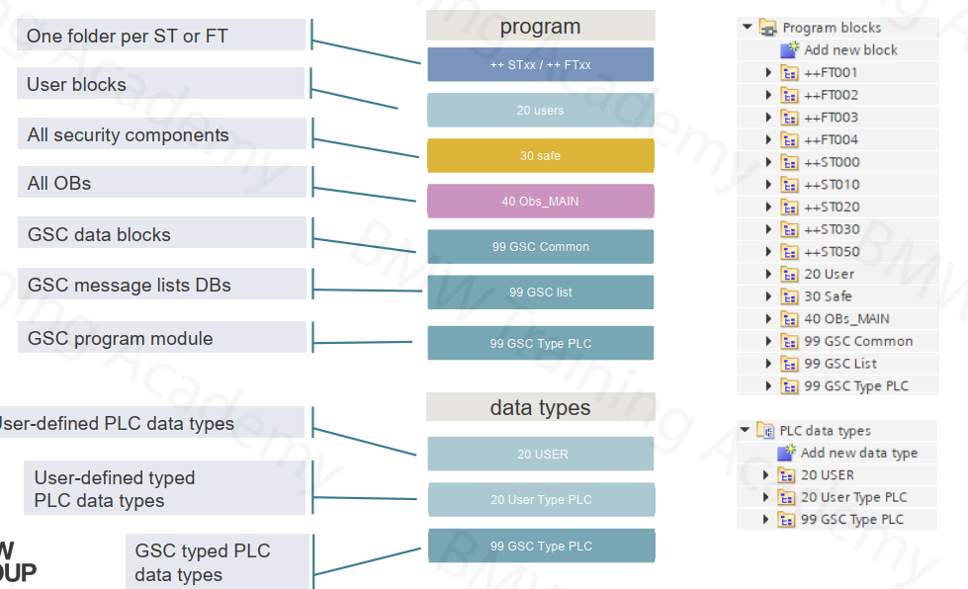
SOFTWARE STRUCTURE - ORGANIZATION

Slide 3
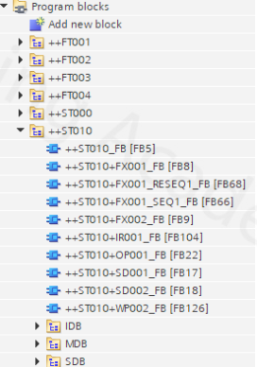
SOFTWARE STRUCTURE – SOFTWARE SETUP
The basic idea of the program structure of the GSC standard is to map the system structure using the identification system. Areas with a common operating mode are formed based on the levels in the identification system, which are also made dependent on faults in the corresponding level in the call structure of the TIA project.
So there is the superimposed station ++ST000. Disturbances at this level affect the overall operating mode of the PLC. Faults in lower levels, such as in the ++ST010, only affect the operating mode area of the ++ST010. The concept of fault inheritance is also reflected for the selection of the areas on the HMI for manual operation.

Slide 4
GROUPING OF COMPONENTS
The software is structured via the station. In addition to this naming and structural grouping, there is also a summary of the grouping regarding the operation of the components of a station : A station can be completely selected and operated in the HMI!

Slide 5
MANAGEMENT OF THE OPERATING MODES
Each component with an operating mode has its own DB (MDB) for managing its specific data. The MODE substructure manages all data relevant to the subject of operating modes . IN / OUT area : Is intended for the communication of the component to its subordinate blocks. The communication is intended exclusively for standard blocks . ONLY the OUT area may also be read in the user program.

Slide 6
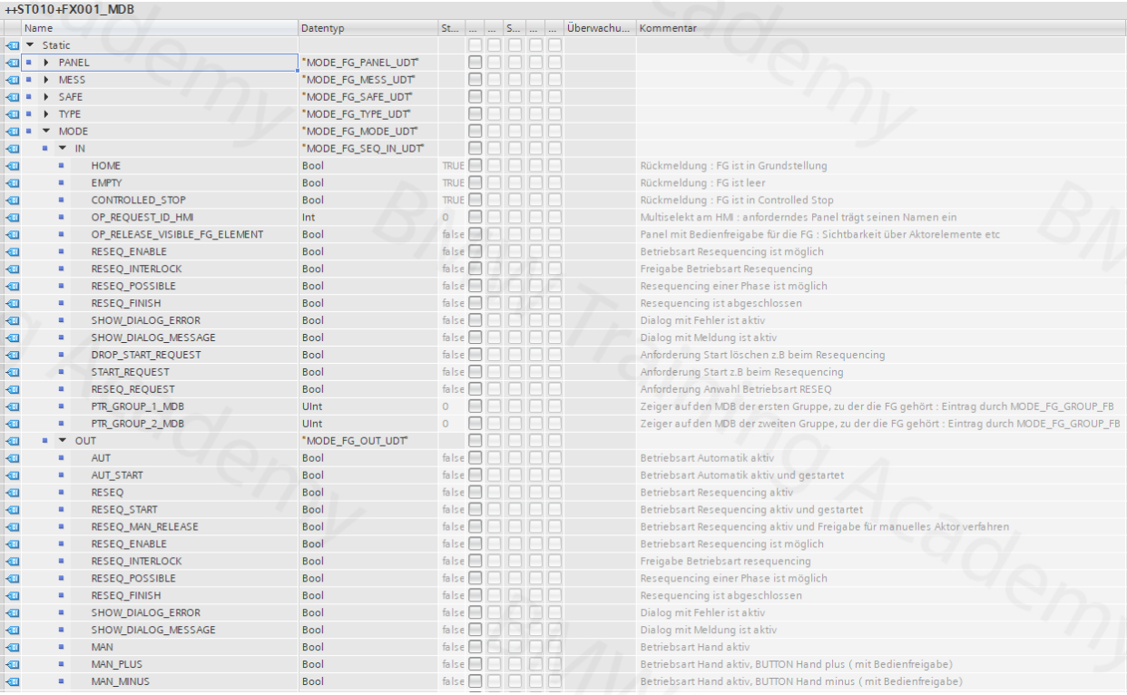
Each component with an operating mode has its own DB (MDB) for managing its specific data. The MODE substructure manages all data relevant to the subject of operating modes

Slide 7
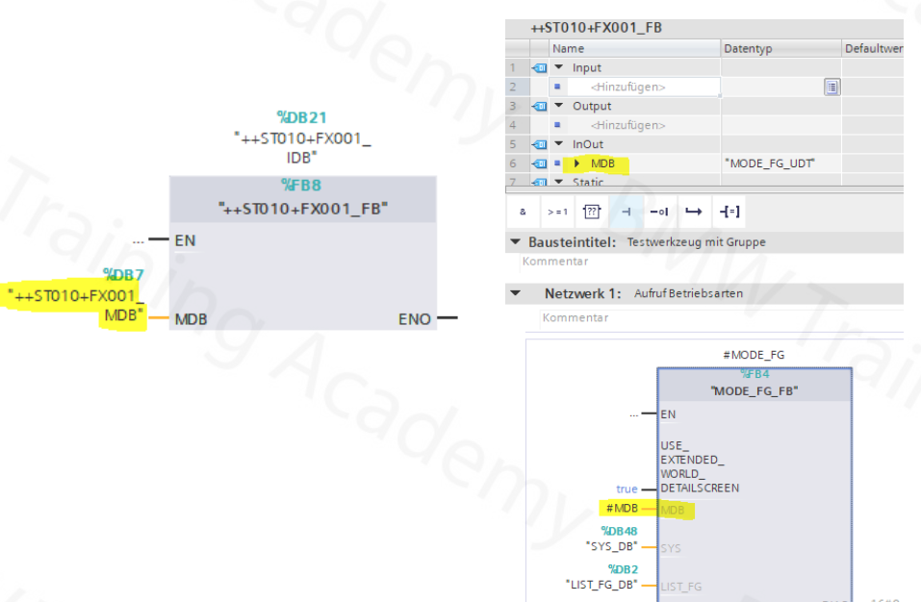
The operating mode DB (MDB) is already parameterized on the component block and then routed to the individual internally called blocks

Slide 14



Contact Us
LINK Group Headquarter
Shanghai, China
LINK Group North China
Shenyang, China
LINK Group Europe (LKGG GmbH)
Bad Reichenhall, Germany
Enquiry
Enquiry
Enquiry
ying.liu@LKautomation.com
kimi.wang@LKautomation.com
jackey.yin@LKautomation.com
+86 021 6918 0161
+86 021 6918 0161
+86 186 2171 9367
Sales
Sales
Sales
gene.zhang@LKautomation.com
gene.zhang@LKautomation.com
andreas.reymendt@LKautomation.com
+86 136 2179 1621
+86 136 2179 1621
Address
BLDG #D,North Jiasong Road No.3570 Jiading District,Shanghai,P.R.China
Address
NO. 14 22nd Floor,NO.168-3 Harbin Road,
Shenhe District,Shenyang,Liaoning
Province,P.R.China
Address
Fischerbraeuwiese 18b,83435 Bad
Reichenhall,Bavaria,Germany

